Slide 1


GitHub Tutorial
A Quick Guide

Slide 2

Contents
Git & GitHub
Version Control System (VCS)
Centralized Vs Distributed VCS
GitHub Terminology
Create an Account
Profile Page
Create a Repo
Create a Branch
Make a Commit
Open a Pull Request
Merge Pull Request
Resources

Slide 3


Git & GitHub
Git
Version Control System (VCS)
Other VCS: Mercurial, Microsoft TFS, Subversion
GitHub
The service that hosts Git projects

Slide 4
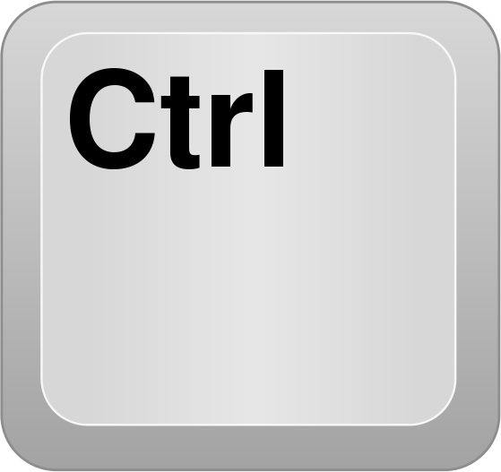
Version Control System (VCS)
a system that help you maintain a detailed history of the project as well as the ability to work on different versions of it.
This is important because it lets you see the progress of the project over time. If needed, you can also jump back to any point in the project to recover data or files.
Two types of VCS:
Centralized VCS
Distributed VCS (like Git)

Slide 5
Centralized Vs Distributed VCS
Centralized Version Control System (CVCS)
One central computer that holds the project.
Every interaction must go through this computer.
Distributed Version Control System (DVCS)
Each developer has a complete copy of the project on their
Computers.

Slide 6
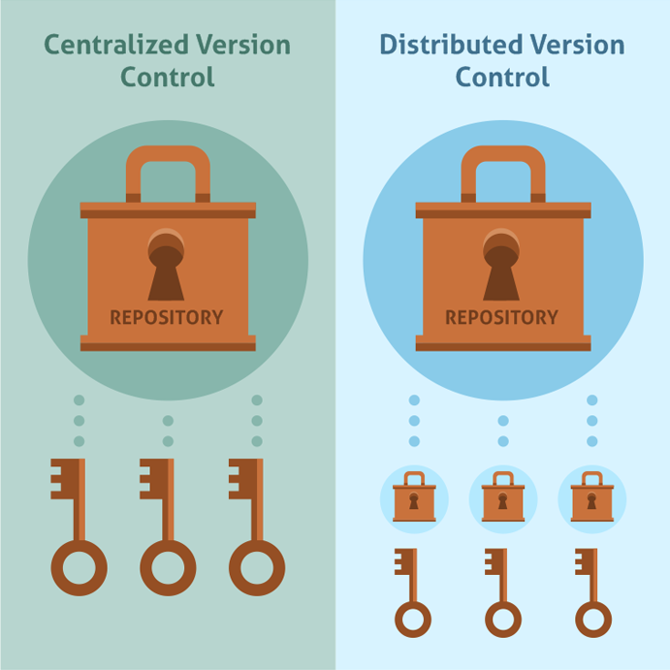
Centralized Vs Distributed VCS

Slide 7
GitHub Terminology
Repository (Repo)
a digital directory or storage space where you can access your project, its files, and all the versions of its files that Git saves.
Branch
the way to work on different versions of a repository at one time. By default your repository has one branch named master. We use branches to experiment and make edits before committing them to master.

Slide 8
GitHub Terminology
Commit
a package of all the changes made since the last commit.
Pull Request
proposing your changes and requesting that someone review and pull in your contribution and merge them into their branch. Pull requests show diffs, or differences, of the content from both branches. The changes, additions, and subtractions are shown in green and red.
Release
a full package commit.

Slide 9
GitHub Terminology
Contributors
people who have worked and helped maintain a project.

Slide 10
Create an Account
Go to https://github.com/join
Type a user name, your email address, and a password.
Choose Sign up for GitHub, and then follow the instructions.
Verify your email address.

Slide 11
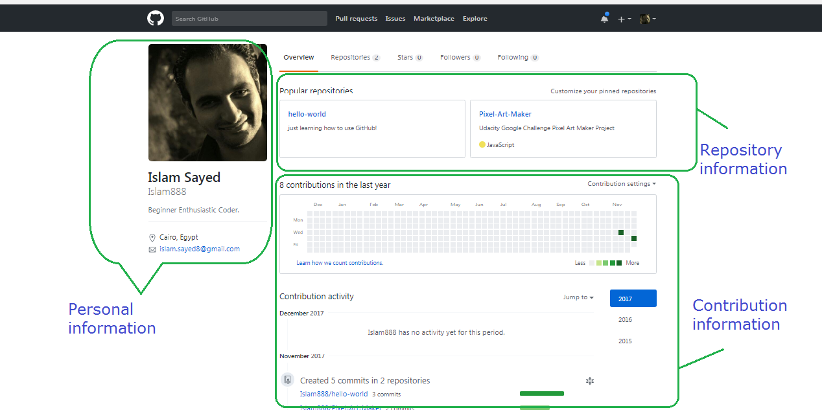
Profile Page

Slide 12
Profile Page
Personal information
Your avatar, contact information, followers, stars and organizations.
Repository information
list of all repositories with you’ve interacted.
Contribution information
a blank graph. Each square turns darker green with more contributions for that day. And detailed contributions information below it.

Slide 13
Create A Repo
In the upper right corner, next to your avatar or identicon, click + and then select New repository.
Give it a name.
Write a short description.
Select Initialize this repository with a README.
Click Create repository.

Slide 14
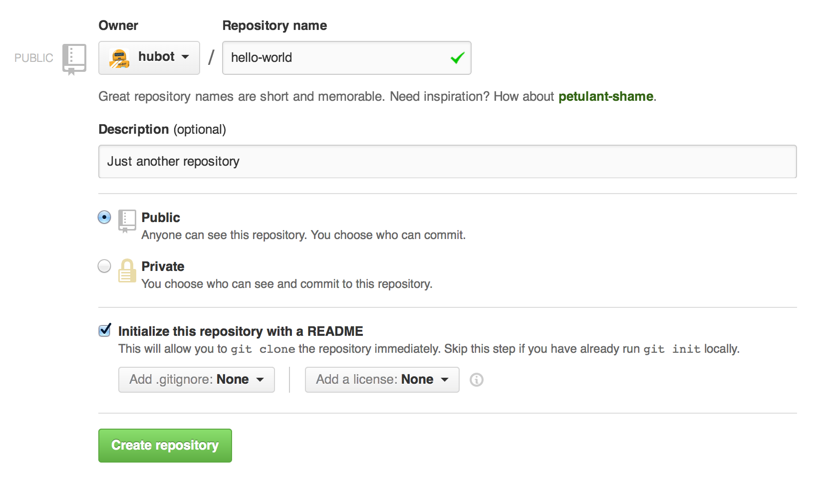
Create A Repo

Slide 15
Create a Branch
Go to your new repository.
Click the drop down at the top of the file list that says branch: master.
Type a branch name into the new branch text box.
Select the blue Create branch box or hit “Enter” on your keyboard.

Slide 16
Create a Branch

Slide 17
Create a Branch
When you create a branch off the default master branch, you’re making a copy, or snapshot, of master as it was at that point in time. If someone else made changes to the master branch while you were working on your branch, you could pull in those updates.

Slide 18
Make a Commit
Click a file in the new branch.
Click the pencil icon in the upper right corner of the file view to edit.
In the editor, write a bit about yourself.
Write a commit message that describes your changes.
Click Commit changes button.

Slide 19
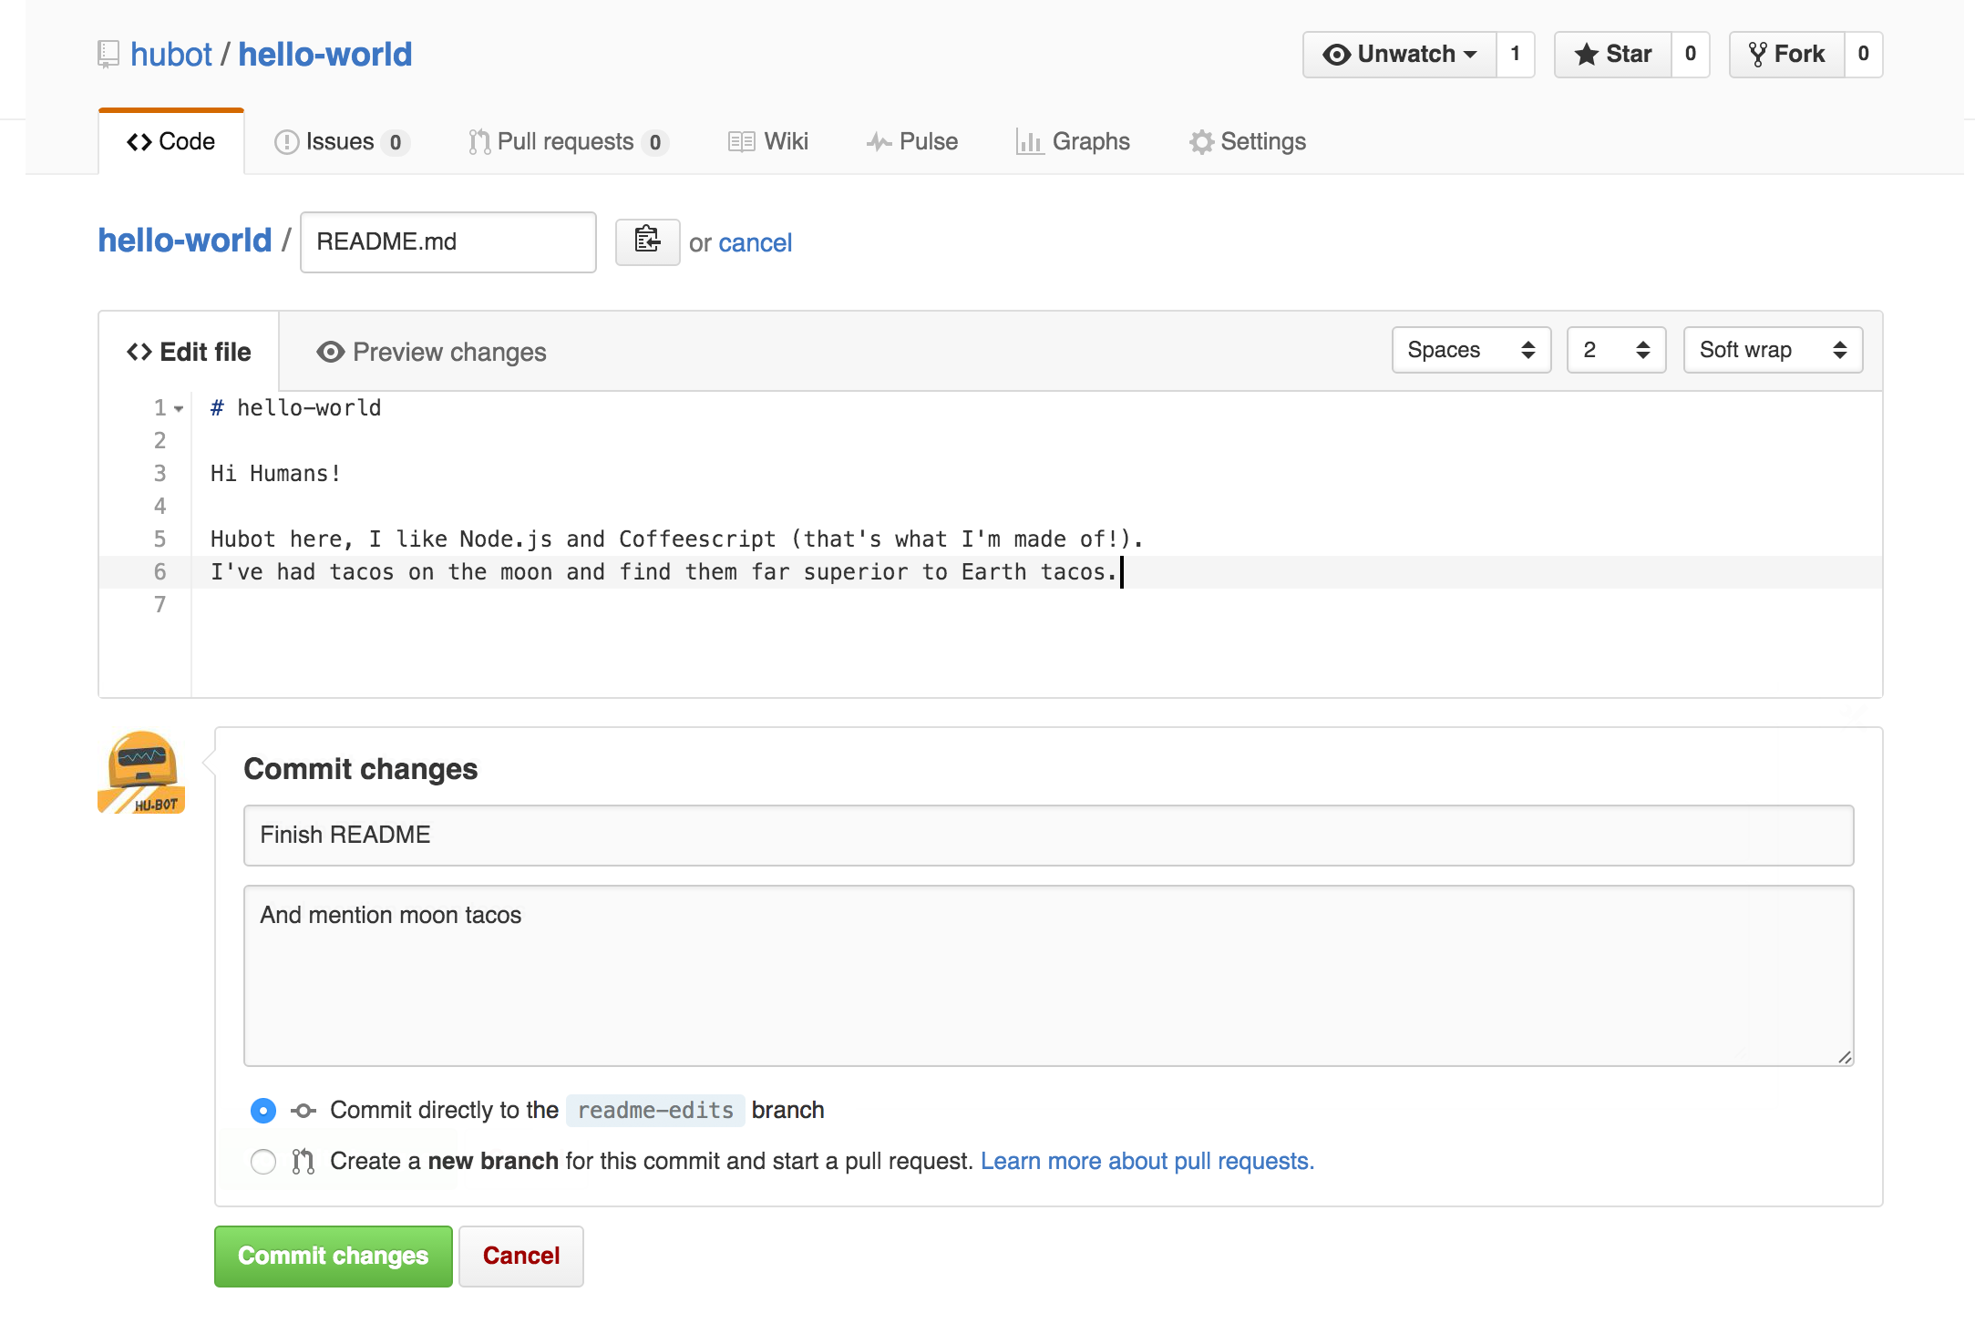
Make a Commit

Slide 20


Open a Pull Request
Click the Pull Request tab, then from the Pull Request page, click the green New pull request button.
In the Example Comparisons box, select the branch you made to compare with master (the original).
Look over your changes in the diffs on the Compare page, make sure they’re what you want to submit.
When you’re satisfied that these are the changes you want to submit, click the big green Create Pull Request button.
Give your pull request a title and write a brief description of your changes.

Slide 21
Open a Pull Request
As soon as you make a commit, you can open a pull request and start a discussion, even before the code is finished.
By using GitHub’s @mention in your pull request message, you can ask for feedback from specific people or teams.
You can even open pull requests in your own repository and merge them yourself

Slide 22


Merge Pull Request
Click the green Merge pull request button to merge the changes into master.
Click Confirm merge.
Go ahead and delete the branch, since its changes have been incorporated, with the Delete branch button in the purple box.

Slide 23
Resources
https://guides.github.com/activities/hello-world/
https://www.youtube.com/githubguides
https://guides.github.com/introduction/flow/
https://www.pluralsight.com/blog/software-development/github-tutorial#
https://octicons.github.com/

